Slide 1
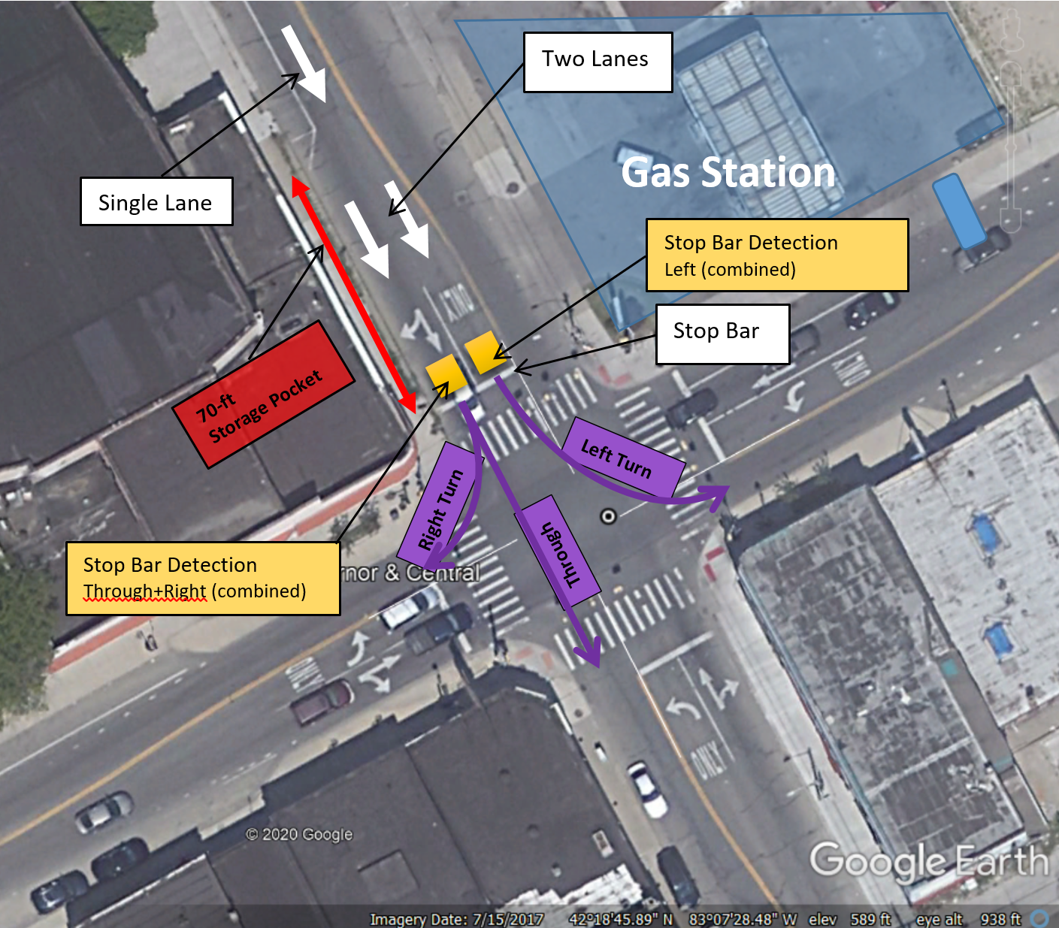
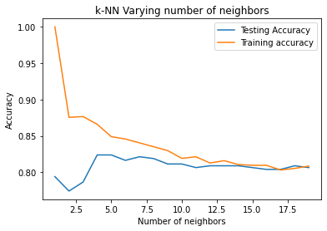
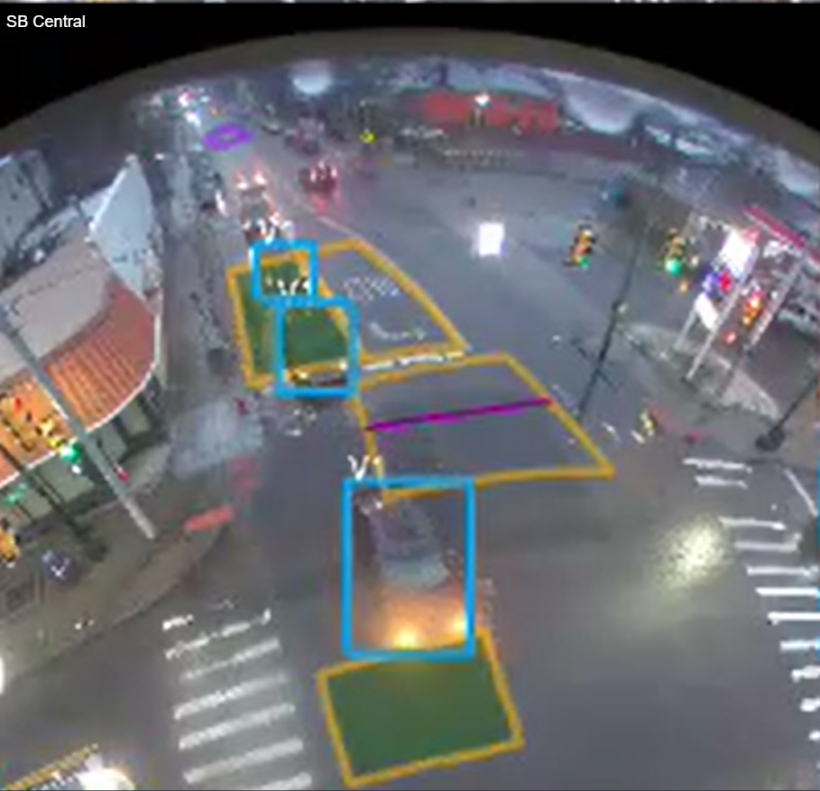
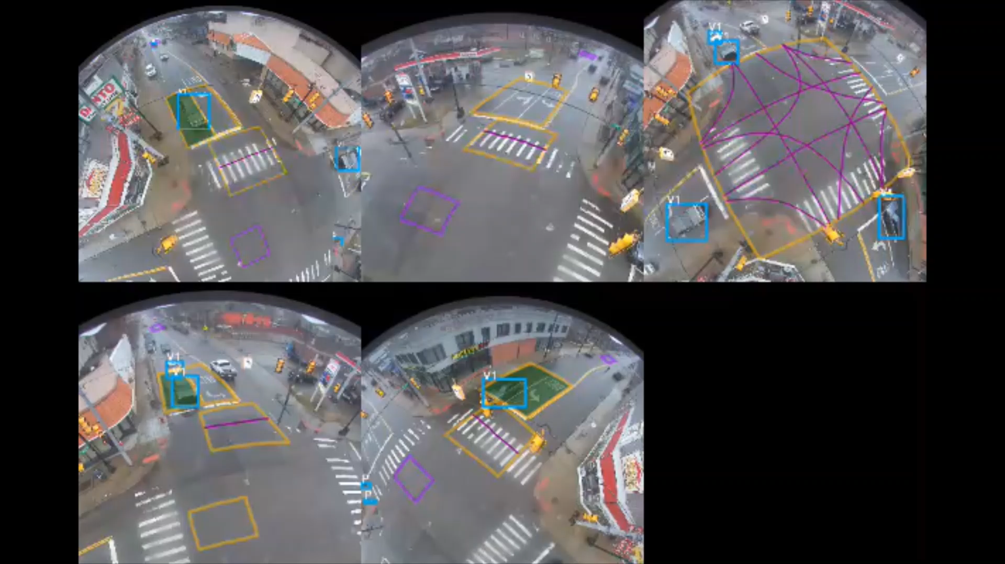
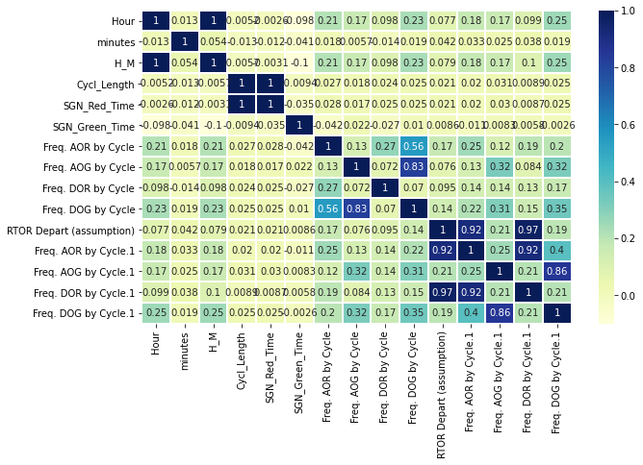
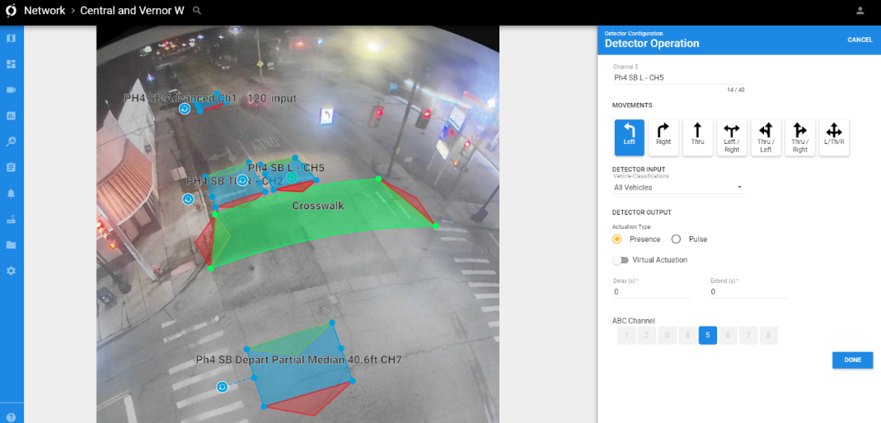
Vehicular Queue Length Classification from High Resolution Stop Bar Detection Data ----------------------------------- CSC5800 – Class Project Fall 2020 ----------------------------------- Rajratna Patil & Tony Geara

Slide 2
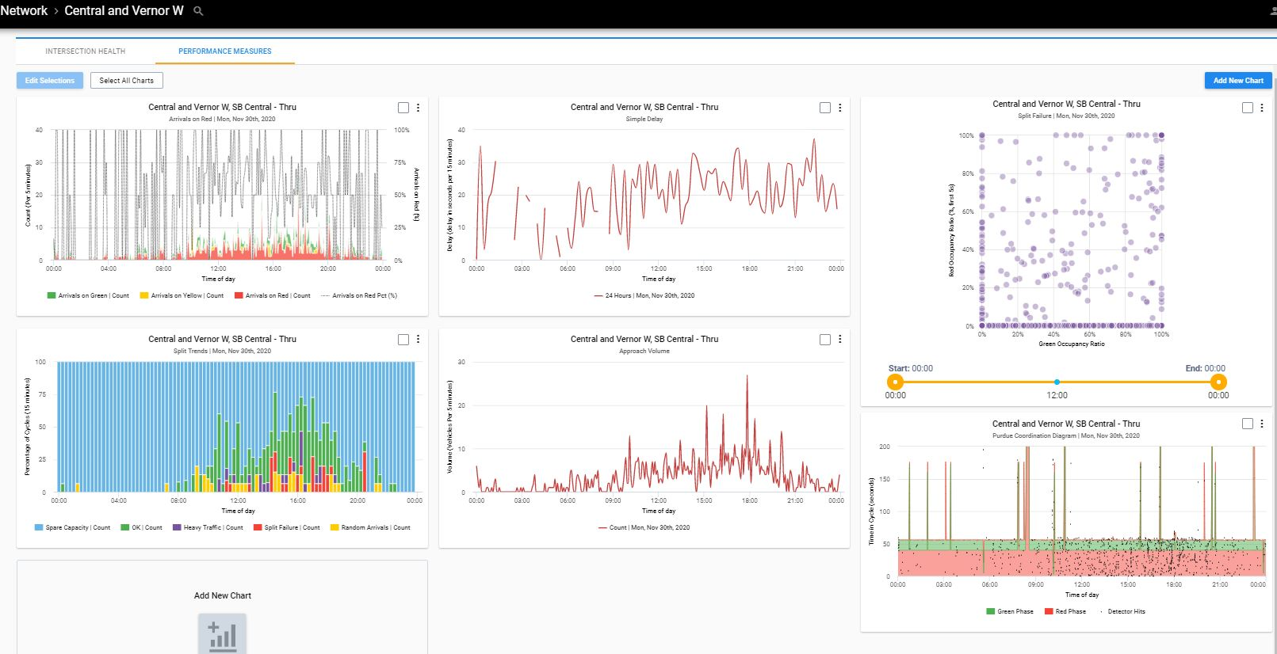
Introduction
Traffic Signal Performance (TSPM)
Automated Traffic Signal performance Measures (ATSPM)
Basic ATSPMs: Approach Volume and turning movement counts,
Advanced ATSPMs: Purdue Phase Determination, Split Monitoring, Pedestrian Delay, Preemption, Split Failures, Approach Delay, Queue Detection, and Arrivals on Red.
Less common ATSPMs: Red Light Running (RLR), Yellow-and-Red actuation, Headway, and Speed.

Slide 3
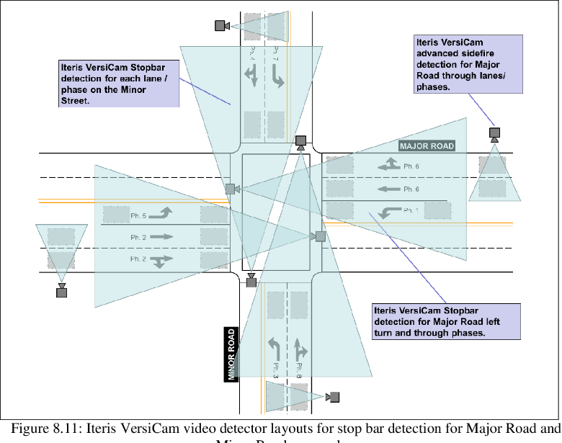
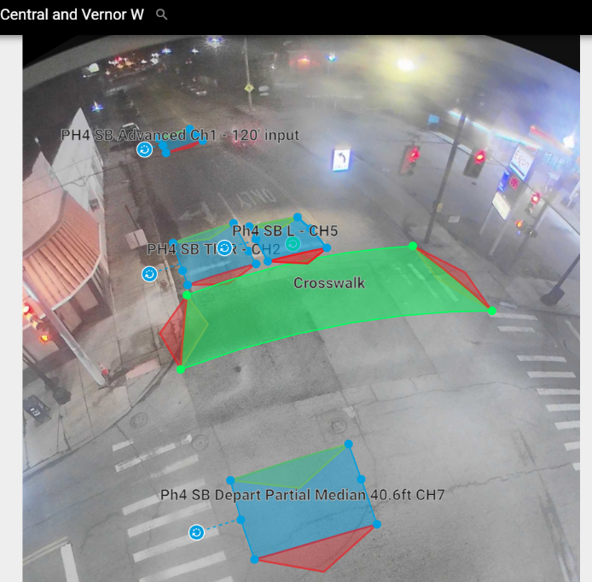
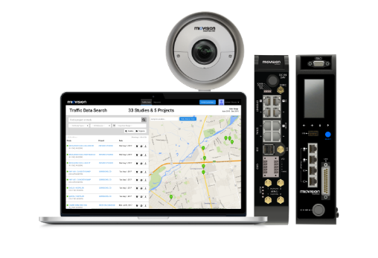
ATSPM Infrastructure
Traditional required installations
Proposed Single-Source Installations

Slide 4
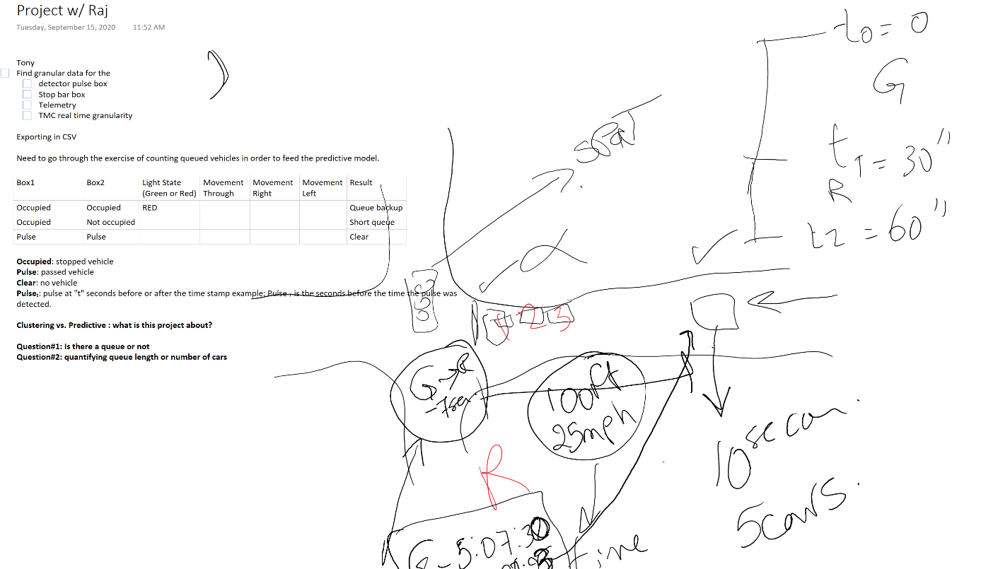
Idea Development
Initial Idea and Hand Sketch (Sept 15)
Proposed Approach (Dec)

Slide 5
Objective Statement
Collect and Visualize existing High Resolution Signal Controller data at an intersections in the city of Detroit.
Attempt to create a Methodology to define the performance measure logic using stop bar detection
Compare/classify queue performance measure using advanced detection (real world) with performance measures using stop bar detection
Allow method to be able to Scale and measure the performance difference between advanced and stop bar logic.
Problem and Objective
Project Statement/Goals
How can we leverage existing HiRes stop bar video detection in the City of Detroit to predict performance (queuing ) at Urban intersections?
If so, how accurately can that be done relative to existing state of the practice metrics?
Are there other existing data that can be leveraged to improve the accuracy of the performance metrics ?

Slide 6
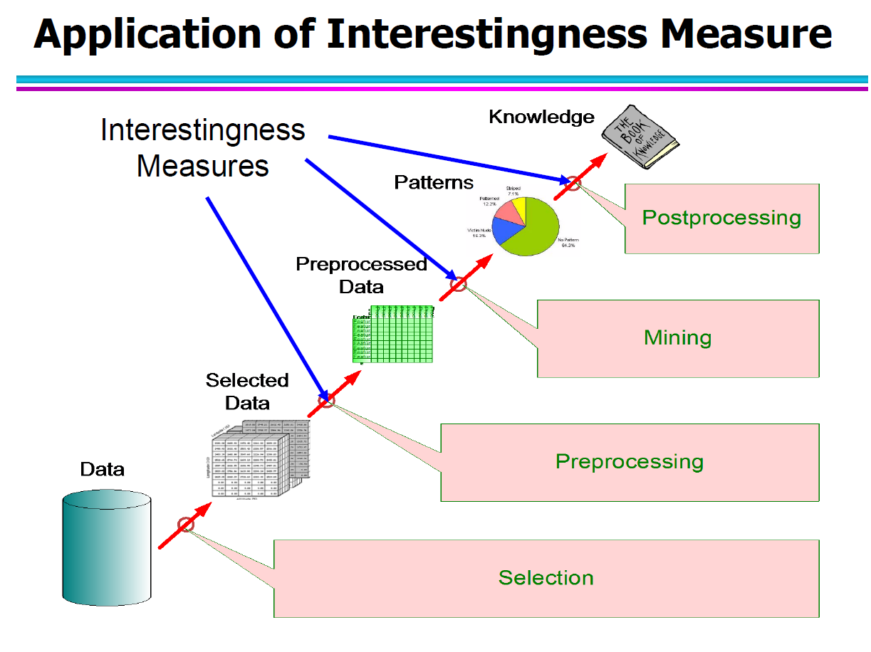
Data Extracted from Miovision API –
November 30th was chosen
Day within the last month with highest southbound movement and overall signal volume for the day and per hour to account for worst case scenario.
High Resolution (HiRes) Data Extracted:
Stop-Bar Detection data
Advance Pulse-Box Detection data
Turning Movement Counts data (TMC)
Aggregated 1-minute Data Extracted”
Turning Movement Counts
Account for Timestamp time in extraction (based on UTC time for the HiRes data and local time for the TMC) – HiRes had to be converted to local time.
Extracted HiRes files were a series of 1-hr groups in JSON format that needed conversion and joining
JSON converted to .txt files then worked with as .csv
Timestamp converted to regular time with millisecond precision (functional time accuracy is to 100 millisecond [i.e.: 0.1 seconds])
Data was checked for errors and gaps (missing data)
A queue estimation model was built from advanced and stop-bar detection boxes (paired with the traffic signal status [red or green]). However, error was high.
Alternatively, a queue estimation model was used from the HiRes TMC data.
Visualization:
HiRes Stop Bar Detection data was graphed for visual inspection of the arrivals on Red and Green.
Recreated Stop-Bar Detection, signal status (and time left on red or green), headway (closeness of vehicles), speed, and historical TMC (some of those items were not accurate enough and were not used in the model).
Model – Queue prediction (classification) discussed next section
Methodology

Slide 7
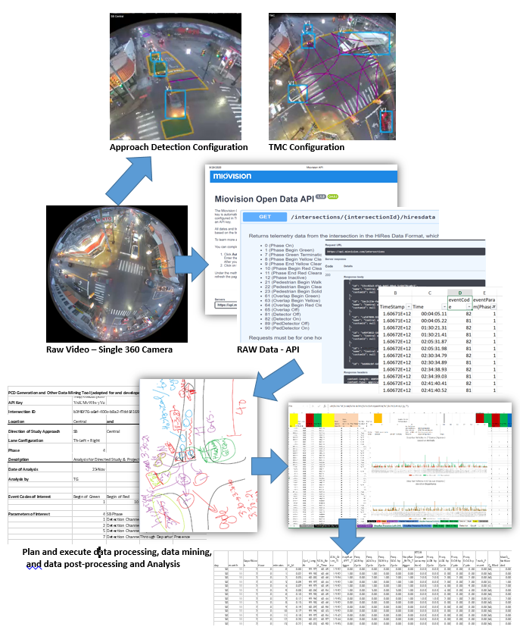
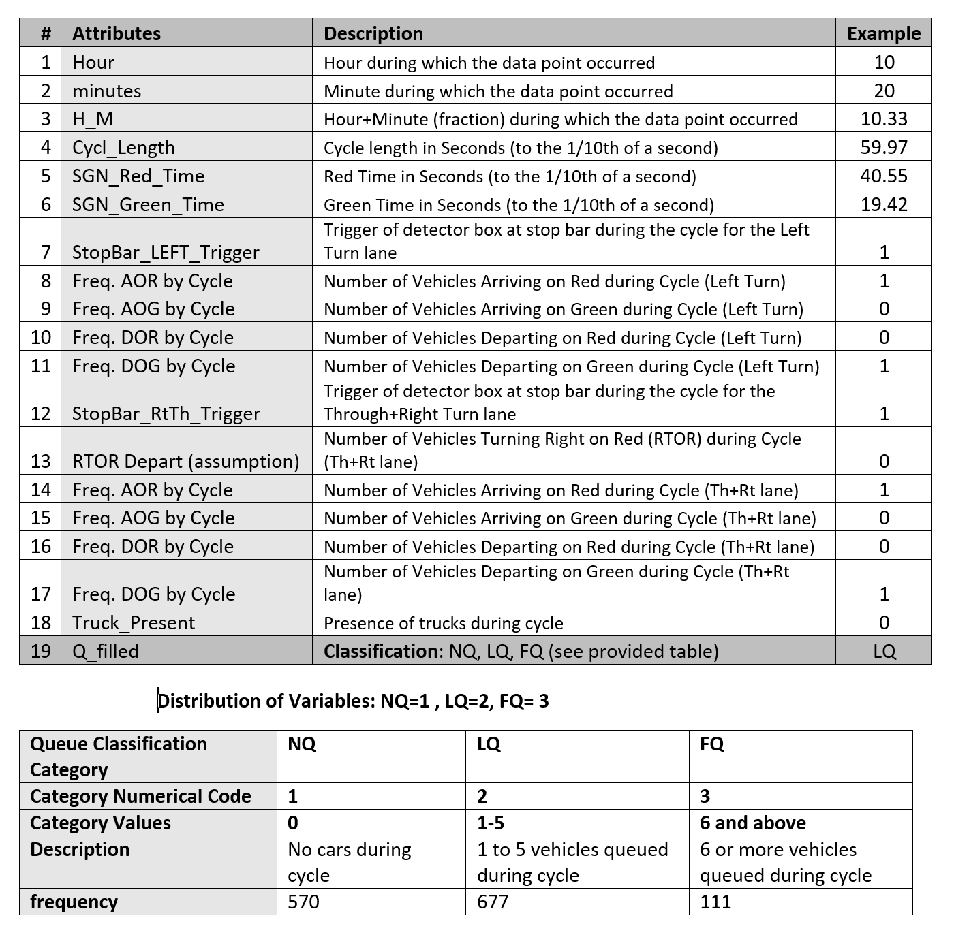
Methodology and Schema
DATA DIMENSION: 1343 x 19 (final set)
Basic Class
Descriptive Statistics

Slide 8

MODEL BUILDING:
Data- Non-Linear
Model –Non-Linear
Models Chosen-
1. Logistic Regression
2. Decision Tree
3. Linear Discriminant Analysis
4. K nearest Neighbors
5. Gaussian Naïve Bayes
6. SVM
7. NN -Multilayer Perceptron
Model Comparison:
MODEL | TRAINING ACCURACY | TESTING ACCURACY
1. Logistic Regression | 0.82 | 0.83
2. Decision Tree | 1 | 0.75
3. Linear Discriminant Analysis | 0.81 | 0.82
4. K Nearest Neighbors | 0.85 | 0.82
5. Gaussian Naïve Bayes | 0.52 | 0.52
6. SVM | 0.85 | 0.85
7. NN -Multilayer Perceptron | 0.85 | 0.85

Slide 9
MODEL BUILDING:
Top-performing Models discovered
KNN-K-Nearest Neighbors
SVM
NN-Perceptron
MODEL | TRAINING ACCURACY | TESTING ACCURACY
K Nearest Neighbors | 0.85 | 0.82
SVM | 0.85 | 0.85
NN -Multilayer Perceptron | 0.85 | 0.85
SVM
MLP
KNN
KNN gives us a balanced classification accuracy, for instance it
predicts class FQ=3 more accurately than other two classifiers.

Slide 10
MODEL BUILDING: WINNER MODEL
Q_filled | Correctly classified SVM | Correctly classified MLP | Correctly classified KNN
NQ=1 | 160 | 160 | 150
LQ=2 | 180 | 179 | 174
FQ=3 | 3 | 4 | 8
KNN gives us a balanced classification accuracy, for instance it
predicts class FQ=3 more accurately than other two classifiers.
WINNER MODEL: KNN K-Nearest Neighbors

Slide 11
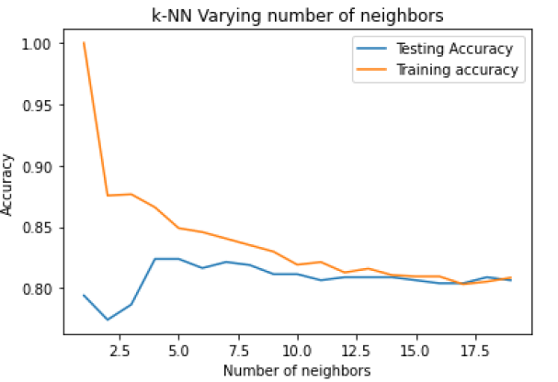
KNN : Choosing K
Q_filled | Correctly classified SVM | Correctly classified MLP | Correctly classified KNN
NQ=1 | 160 | 160 | 150
LQ=2 | 180 | 179 | 174
FQ=3 | 3 | 4 | 8
KNN :
At K= 2 to 3 → Training accuracy is high but testing accuracy is low
→ Training error low and testing error high
At K=5 → Testing and training accuracy are both optimal

Slide 12
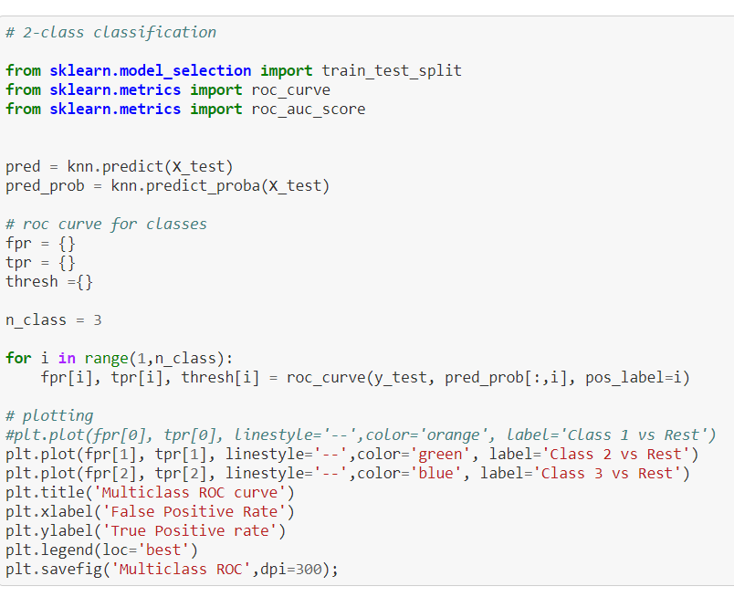
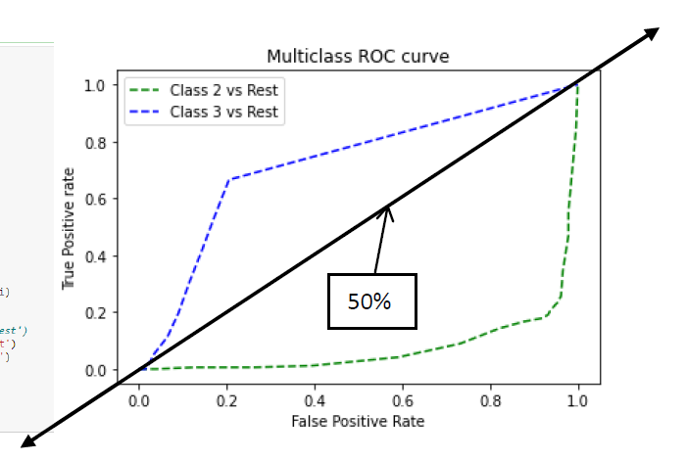
ROC Curve: LQ=2 vs FQ=3
INFERNCE:
LQ=2 → KNN model is a very good model (above 50% chance)
FQ=3 → KNN model is a bad model (below 50%).
But KNN offers much better and balanced than any other model tried so far.
LQ=2 and FQ=3 are penalizing each other
Predicting one better than other possible.
Trade-off between these needs to be based on objective/cost function.
Practically speaking, we need both to be predicted accurately.

Slide 13
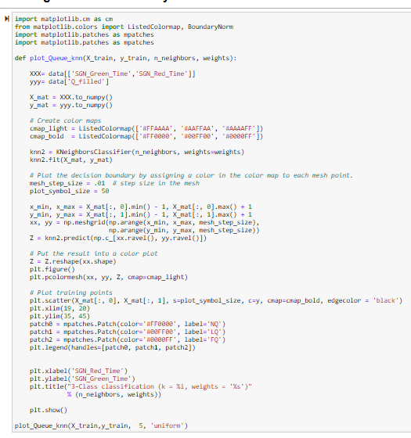
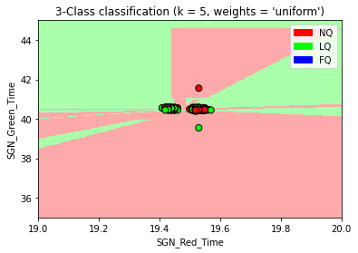
Classification Boundary
INFERNCE:
For NQ=1 and LQ=2 a clear boundary is visible.
But for FQ=3 there is no a clear boundary visible
Reasons:
1. Unbalanced class distribution (FQ=3 significantly low)
2. LQ=2 and FQ=3 penalization issue.

Slide 14
CONCLUSION
Difficult to predict Queue length solely from Stop bar detection –
This project is a first attempt at doing so with a single low investment single-source detection (potential trade: accuracy for price and effort)
Various prediction classification models were tested to provide a comparison (Logistic Regression, Decision Tree, Linear Discriminant Analysis, K Nearest Neighbors, Gaussian Naïve Bayes, SVM, and NN -Multilayer Perceptron).
Top-performing Models: KNN-K-Nearest Neighbors, SVM, NN-Perceptron
K nearest neighbor (KNN) seems to be outperforming the other methods
Predicting NQ and LQ classes: model was accurate.
Predicting FQ class: fell short in all methods and needs further investigation.
Potential reason why results were not as strongly predicted along the three classes:
Uneven class distribution (with much lower instances of FQ compared with the other two classes)
potential data accuracy issues
Further review and refinement of analysis methods and configurations needed
need for a larger data pool

Slide 15

Model Analysis – GitHub Link
https://github.com/rajratnapatil9/TRAFFIC-QUEUE-PREDICTION/blob/main/Queue%20Prediction.ipynb

